Slide 1
Frequency Modulation and Demodulation Expt. No- 5

Slide 2
Frequency Modulation and Demodulation
Expression for Frequency Modulated Wave
As we know from amplitude modulation, we need two sine (or) cosine waves for modulation.
m(t) = Am cos (ωmt) and
c(t) = Ac cos (ωct)
After putting the value of ω,
m(t) = Am cos (2π fmt)
c(t) = Ac cos (2πfct)

Slide 3
Continue…
Then frequency modulated wave will be;
fm(t) = fc + k Am cos (2π fm t )
fm (t) = fc + k m(t)
Where,
fm(t) = is frequency modulated wave
fc → frequency of the carrier wave
m(t) → modulating signal
k → proportionality constant.

Slide 4
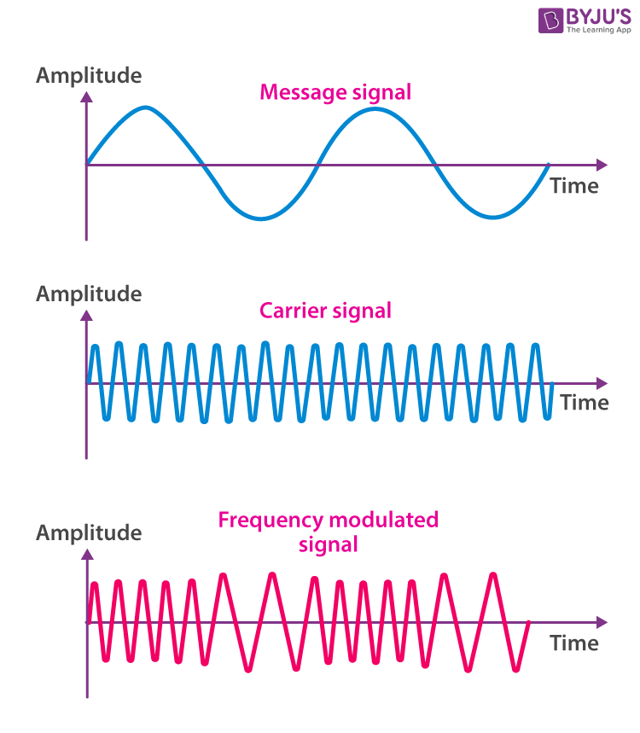
Waveform:

Slide 5
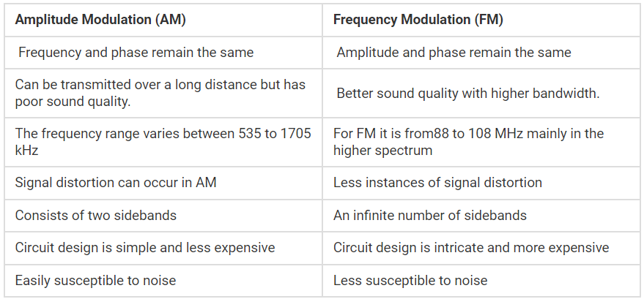
Comparison:

Slide 6
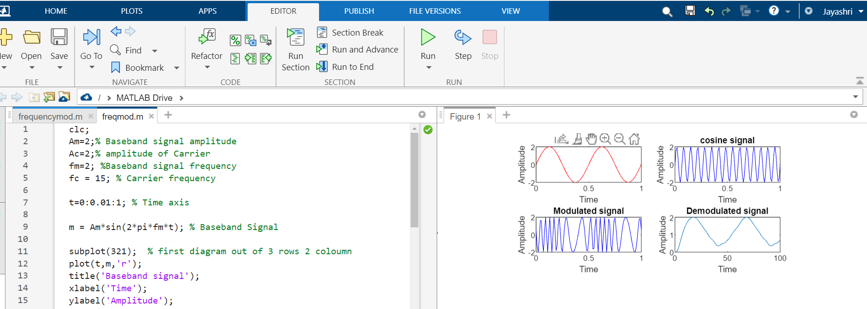
MATLAB Code:

Slide 7
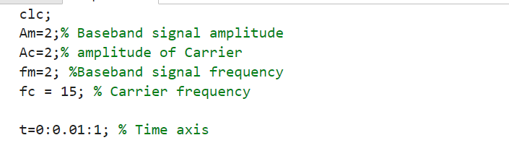
MATLAB code: Initialization:

Slide 8
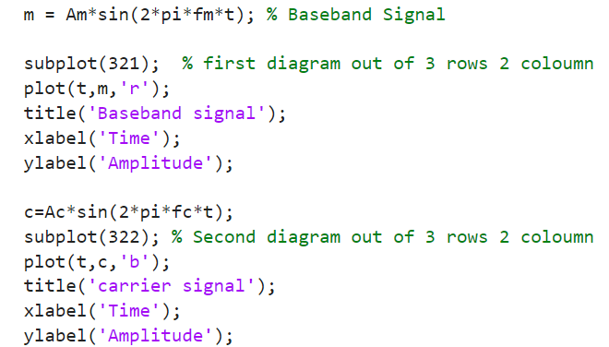
Message and carrier signal:

Slide 9
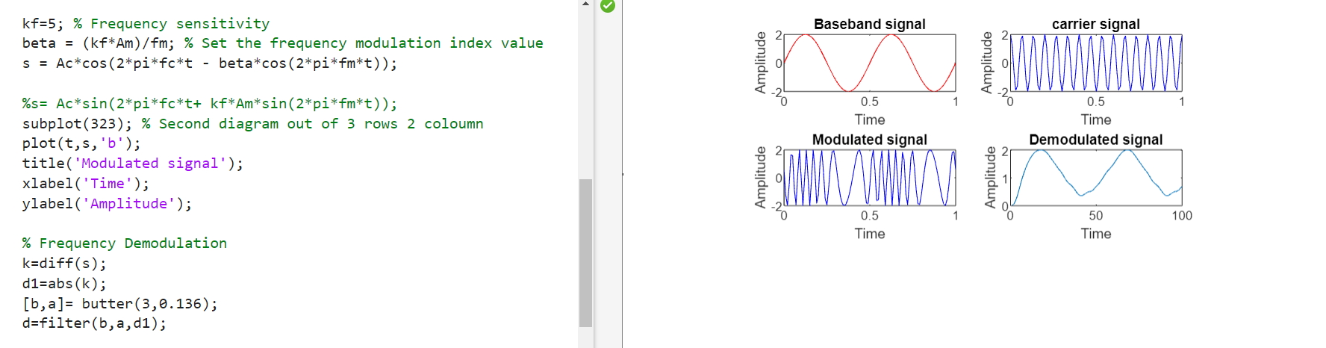
Frequency sensitivity,Frequency deviation, Modulation Index & Frequency Modulated signal :

Slide 10
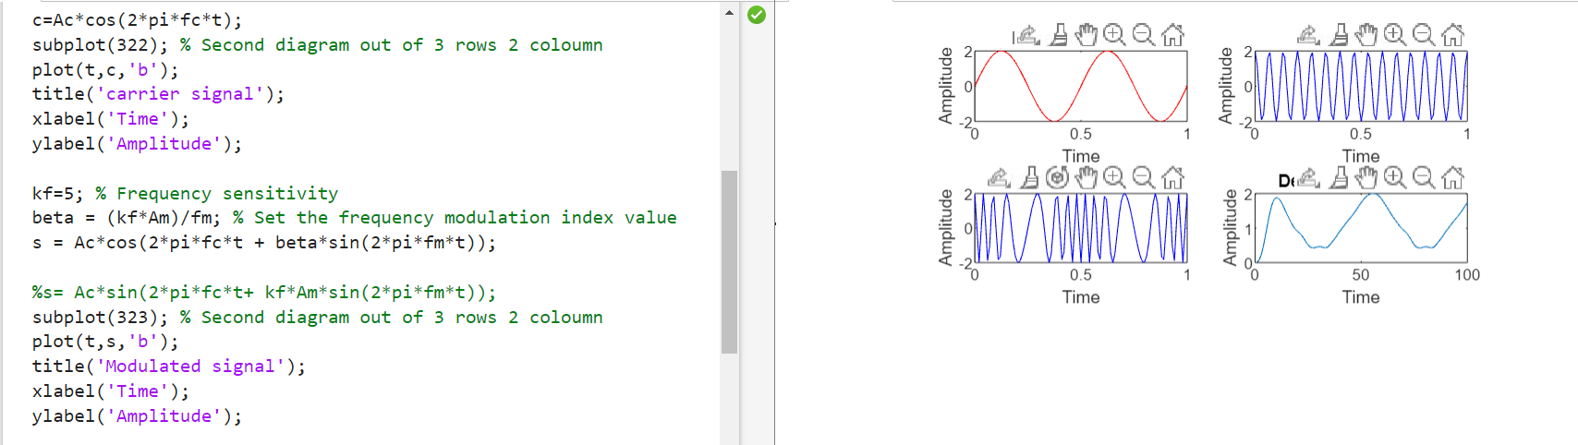
Frequency sensitivity,Frequency deviation, Modulation Index & Frequency Modulated signal :

Slide 11
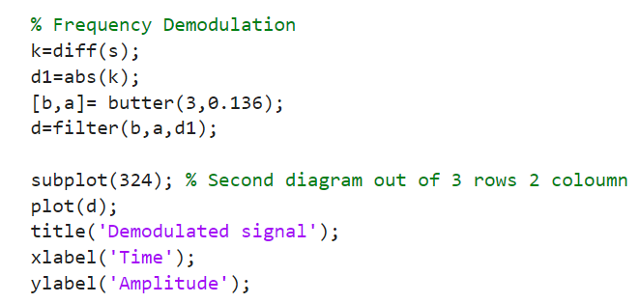
Frequency Demodulation:

Slide 12
Application:
frequency modulation, it is mostly used in radio broadcasting.
It offers a great advantage in radio transmission as it has a larger signal-to-noise ratio.
Meaning, it results in low radio frequency interference.
This is the main reason that many radio stations use FM to broadcast music over the radio.

Slide 13
References:
[1]https://byjus.com/jee/frequencymodulation/#:~:text=Frequency%20modulation%20is%20a%20technique,frequency%20of%20the%20modulating%20signal.
[2] “B.P.Lathi”, Modern Digital and Analog Communication Systems Chapter 4.

